Slide 3


Slide 4

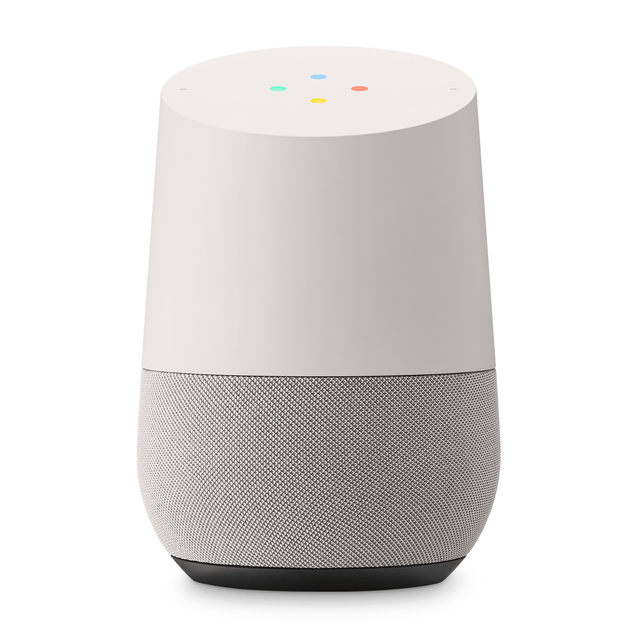
Building your own
Assistant
05-03-2019

Slide 5


Who we are
Matthisk Heimensen
Mike Woudenberg

Slide 6
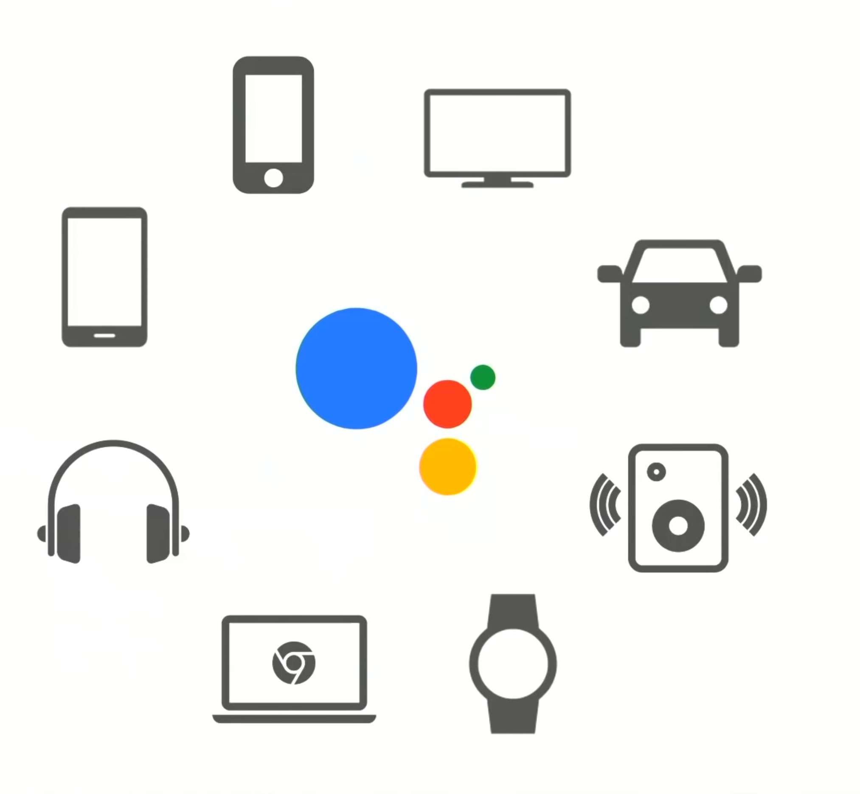

Slide 7

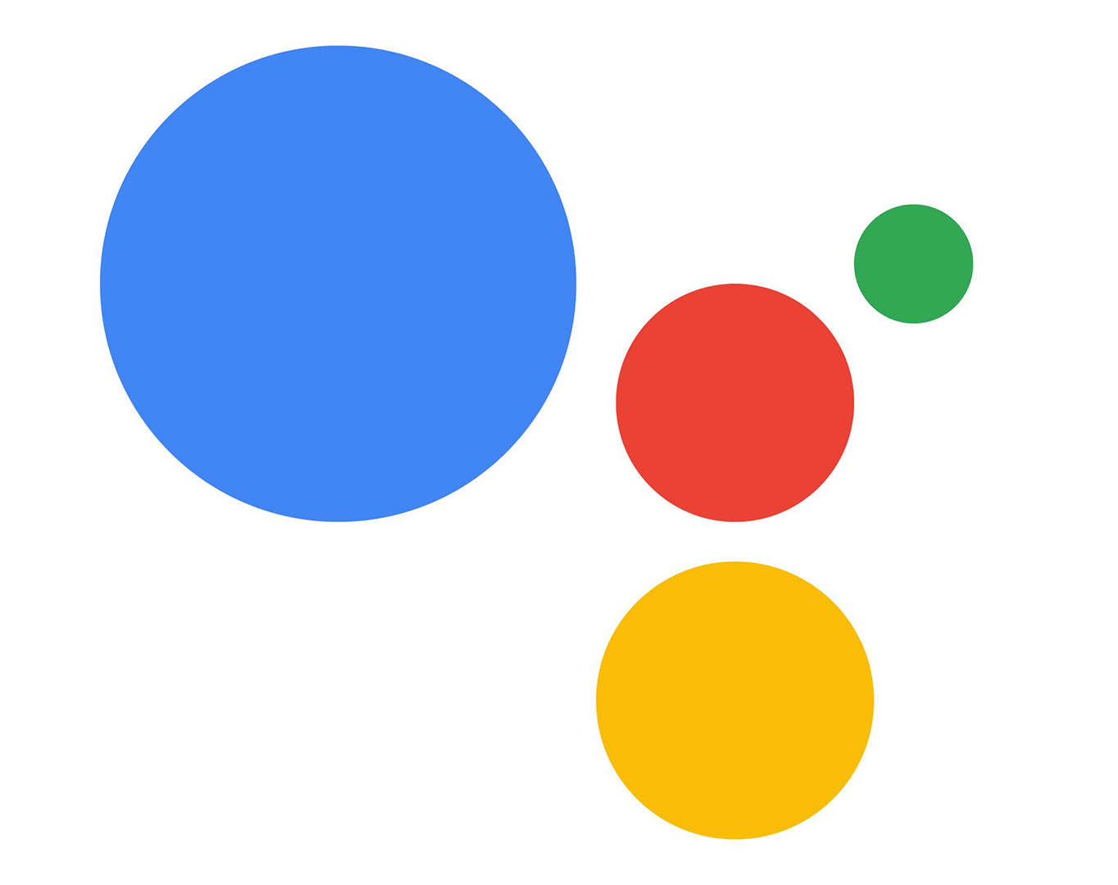
Dialogflow
Google Assistant

Slide 8
OK Google,
Talk to XKEA
Dialogflow
Google Assistant

Slide 9


Slide 10
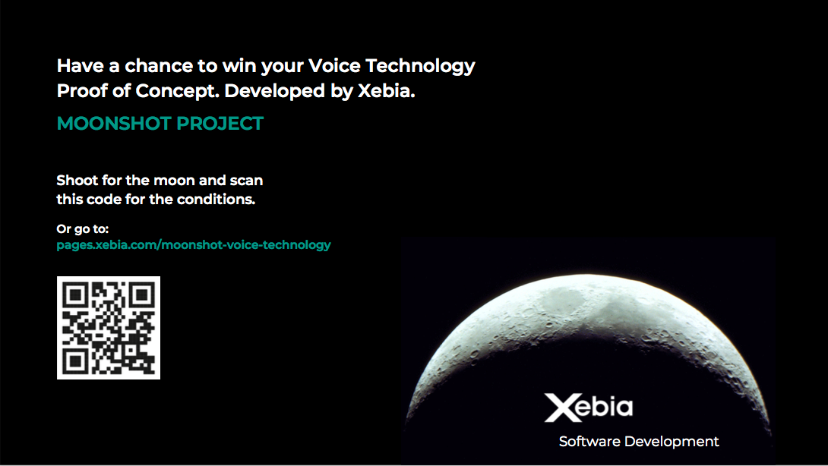

Slide 11
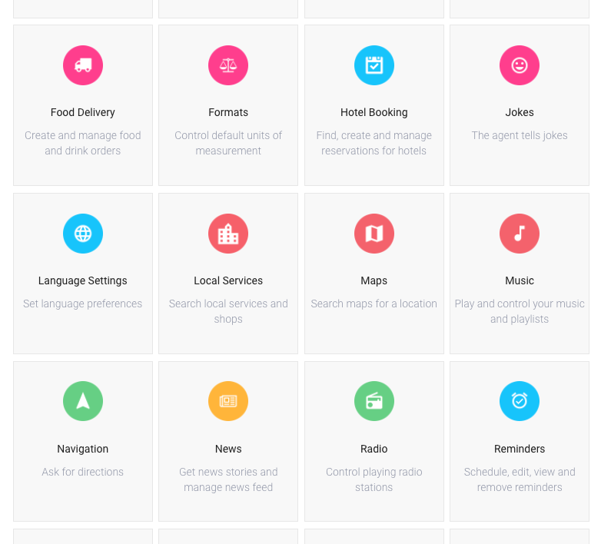
Pre-built agents help you get a head start

Slide 12
A world-class conversational interface is a multi-step process
1
2
3
4
5
6
7
Identify top user journeys that could be automated
Build business plan
Design a persona
Write professional scripts
Connect to backend enterprise systems
Build PoC and collect feedback
Connect to human agent system for human intervention

